Slide 1
MO creation
Odoo version 11

Slide 2
Revision History
KOKO Manufacturing User Manual V1

Slide 3
Objective
The objective of this training is to ensure that the Maintenance, Assembly,Deployment and Production Engineering teams have a clear understanding of:

Slide 4
Abbreviations

Slide 5

List of Abbreviations
KP- KOKOpoint

Slide 6
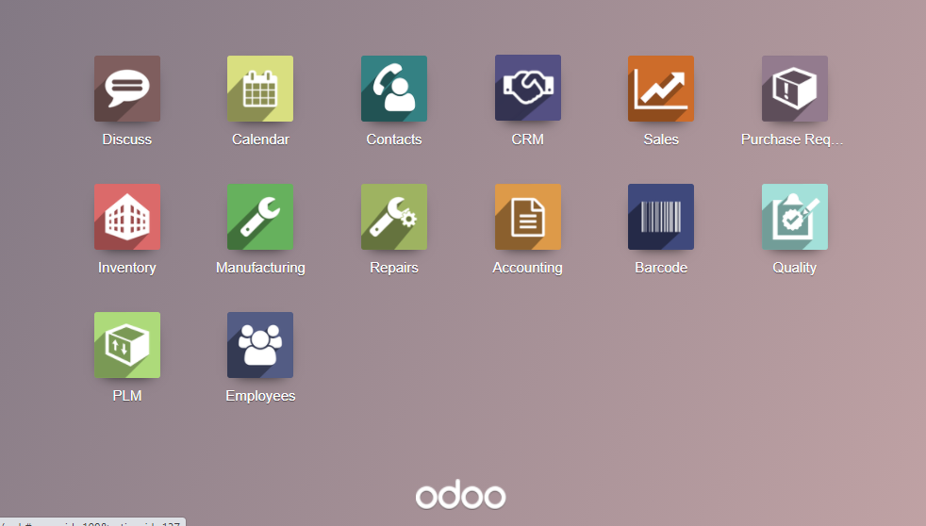
Step 1 - At the the Odoo icons select ‘Manufacturing’

Slide 7
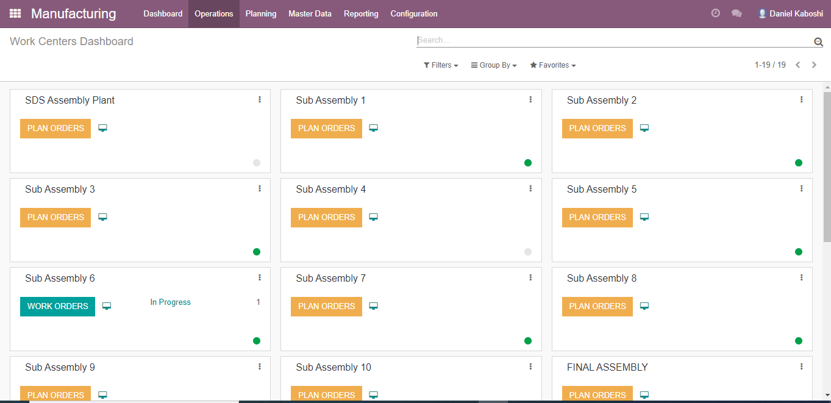
Step 2 - Click on operations

Slide 8
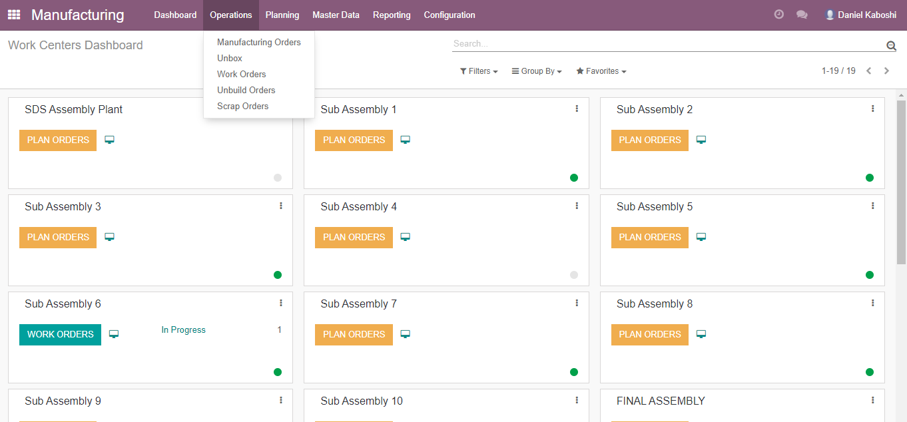
Step 3 - At operations dropdown select manufacturing orders

Slide 9
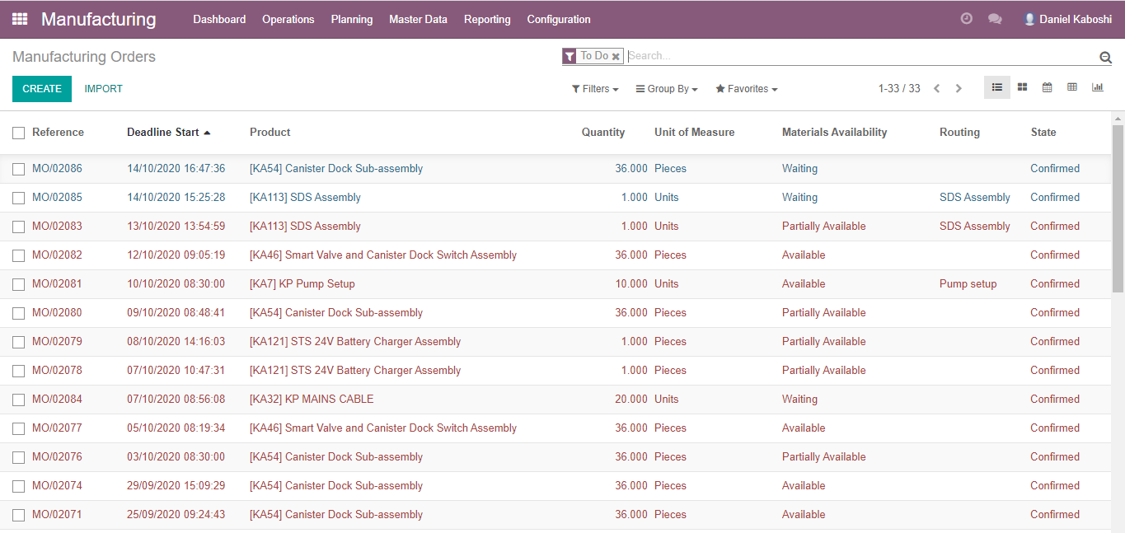
Step 4 - Click on the create button

Slide 10
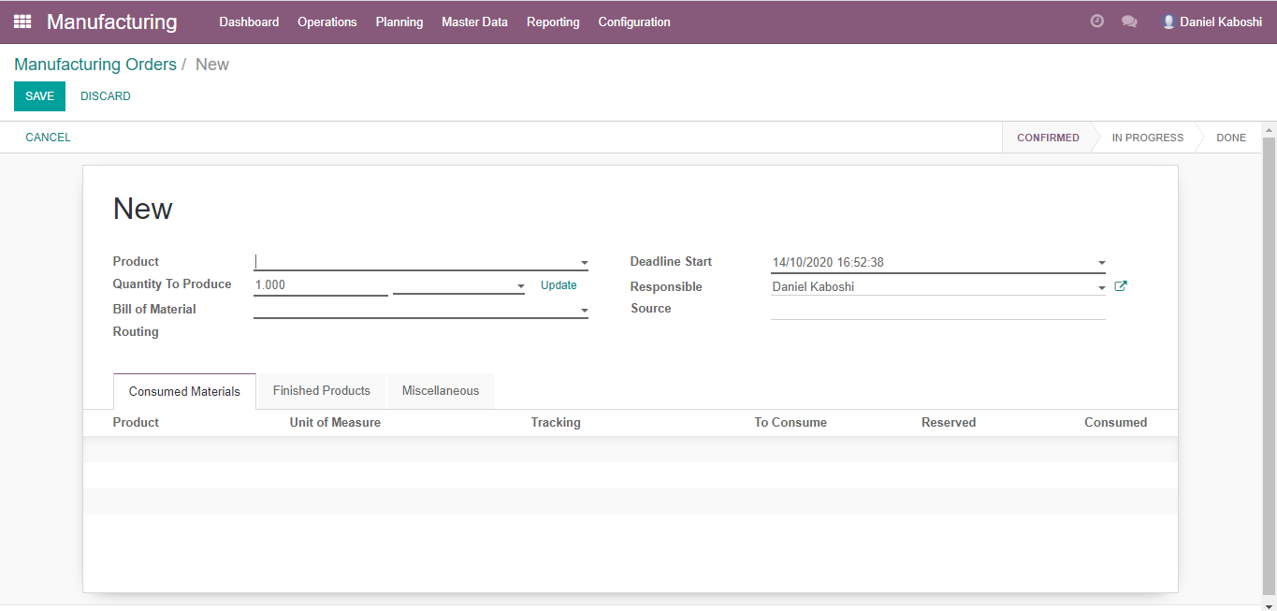
Step 5 - Add product details e.g KA46 and qty to produce e.g 36 and save

Slide 11
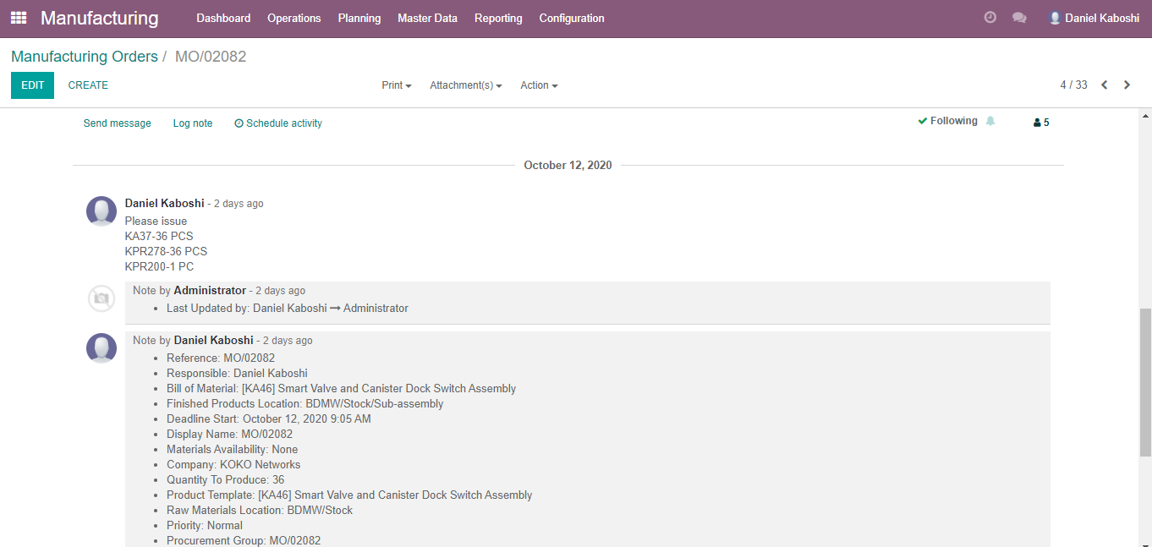
Step 6 - Scroll down and add followers

Slide 12
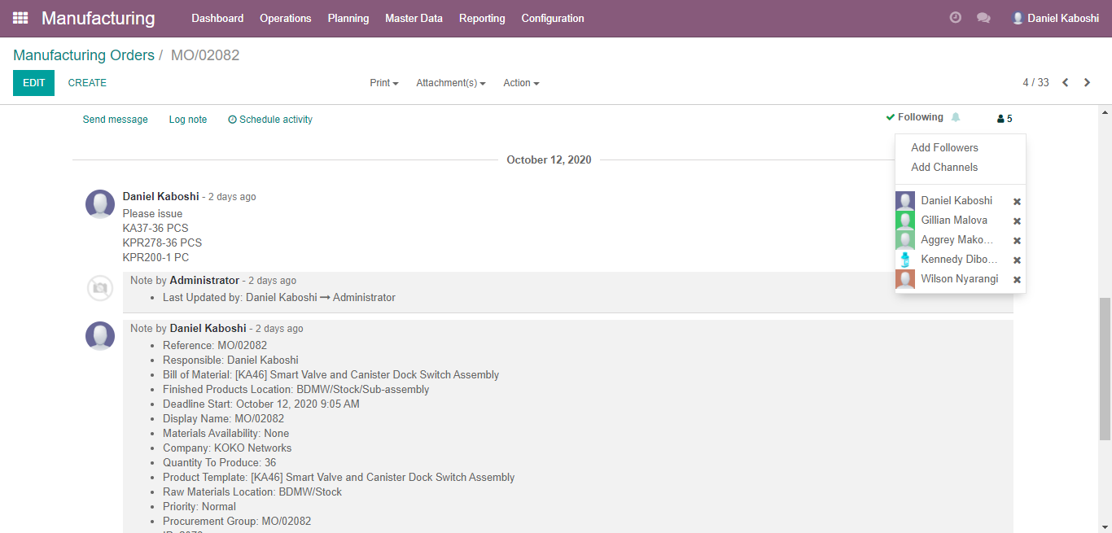
Step 7

Slide 13
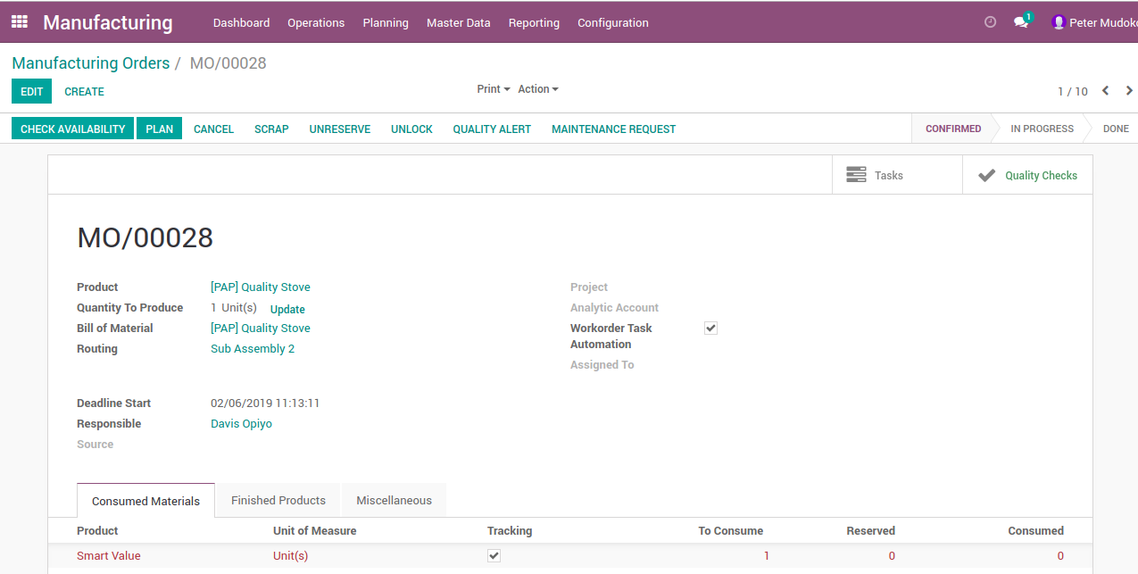
Processing MO
Click plan
Plan: It will create individual work orders click on them you will see the work orders
End users will log in and see work orders at their respective work centers
if green then the work order is s in process, the first one will be green and in the state of ready to process while all other work orders will be in state of pending

Slide 14
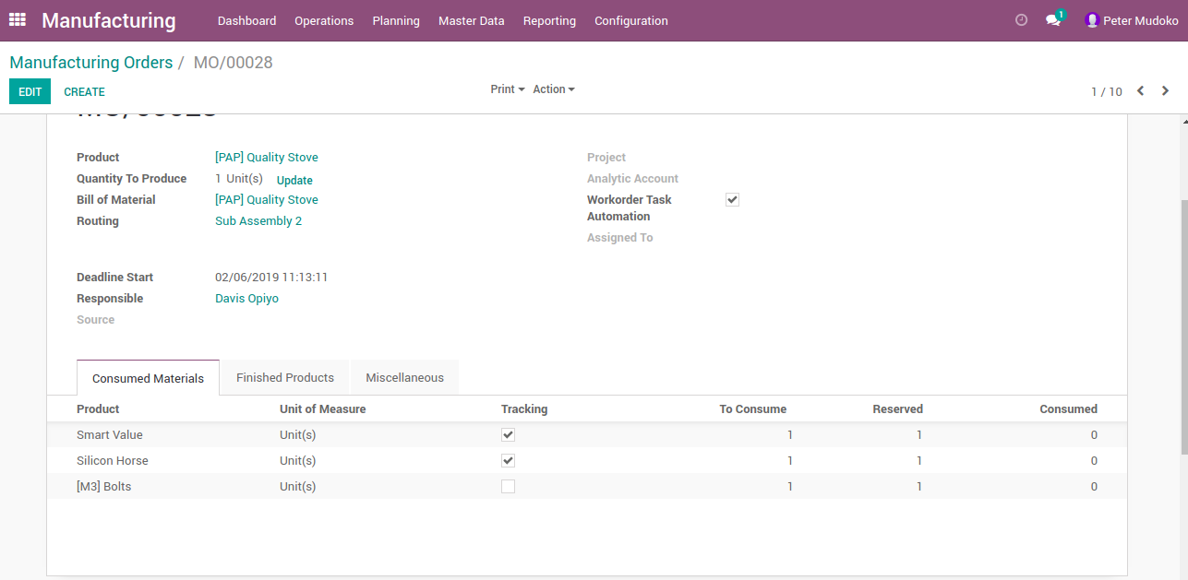
Open the work order , you see worksheet , you can zoom in the sheet, move page to page it has set of instructions for the process at the work center,

Slide 15
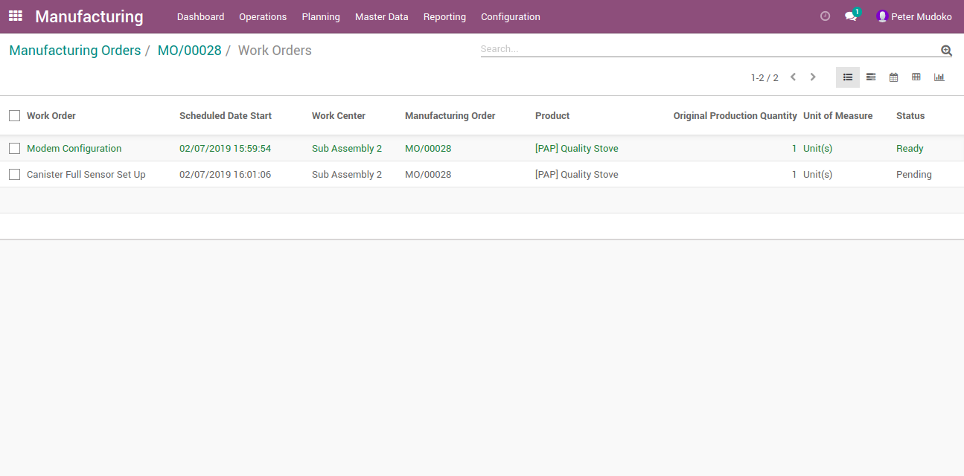
Open the work order , you see worksheet , you can zoom in the sheet, move page to page it has set of instructions for the process at the work center,

Slide 16
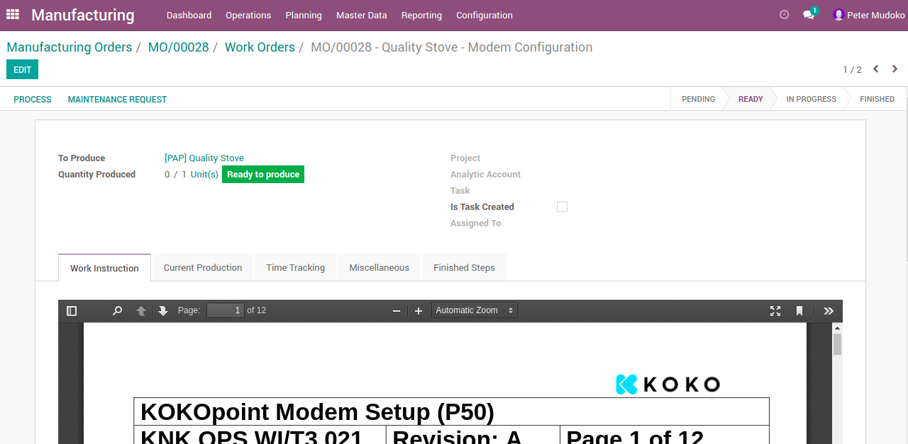
Hit Process, you can pause eg go on lunch as manager you can see time entries logged by the system you can see logged in user
At any time you can block it will freeze the work at the work station , maybe because of failure of an operation

Slide 17
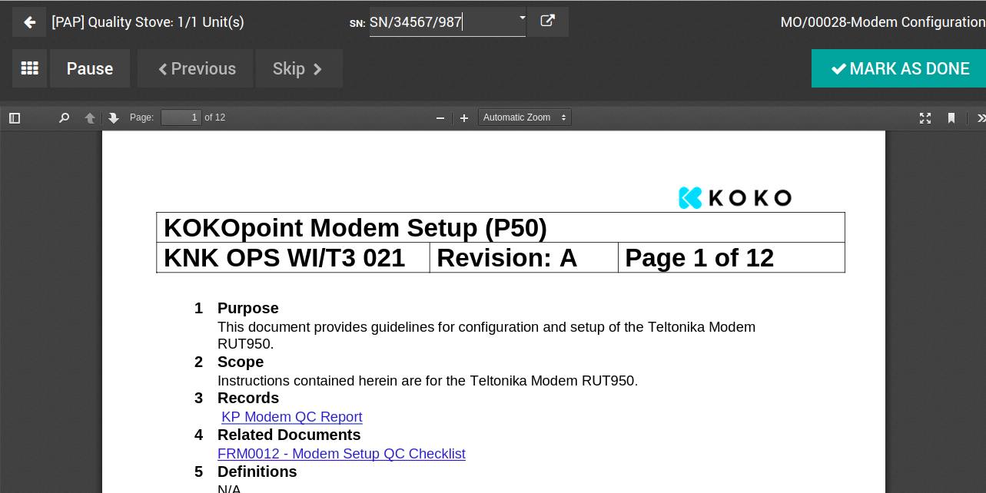
Mark as done the work order to finish the work order

Slide 18
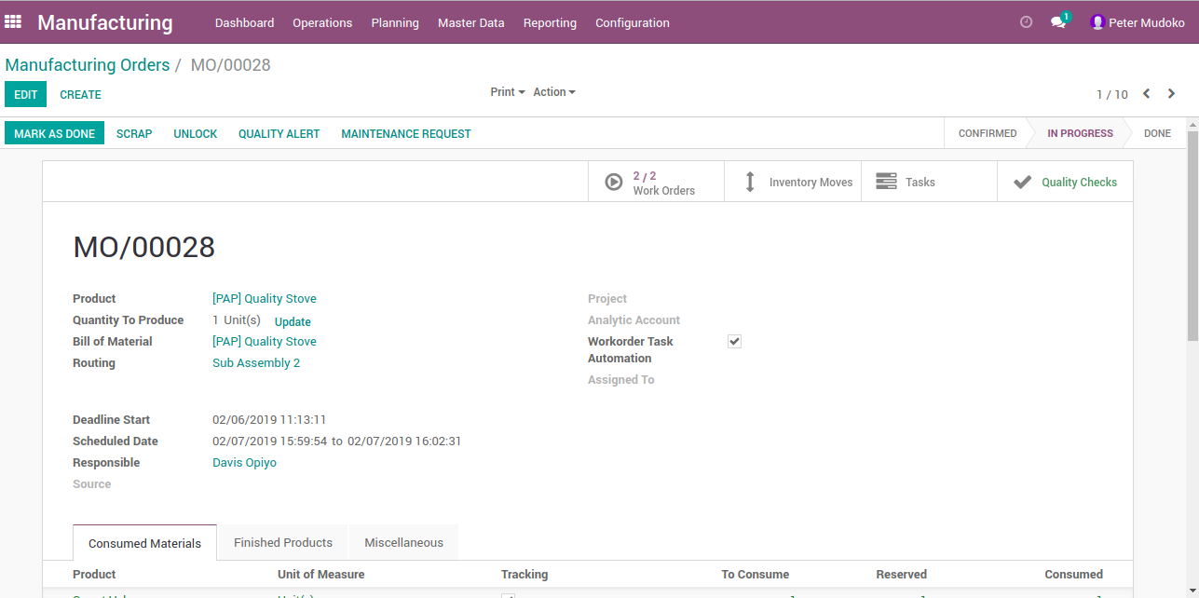
After marking as Done all work orders, go back to original manufacturing order, showing state as ‘in progress’ Open it and click ‘Mark as Done’

